Slide 1

Academic Success with FEV Tutor 2022-2023
Presented By : Prajwali Gandhare

Slide 2
Objectives
To Derived this Dashboard to Recognizing FEV Tutor’s Research – Based approach and ability to accelerate students outcomes.
To Implement the Performance of FEV Enrolled & Non-FEV Enrolled Students According to Academic Year.
To Derived the Students Results and Overall Percentages of their Performance in FEV Tutor’s Pre & Post Test.
To Maintain the Information of Students Types, Total Participants, Total Students, Session Attended & Ticket Exits Score.

Slide 3
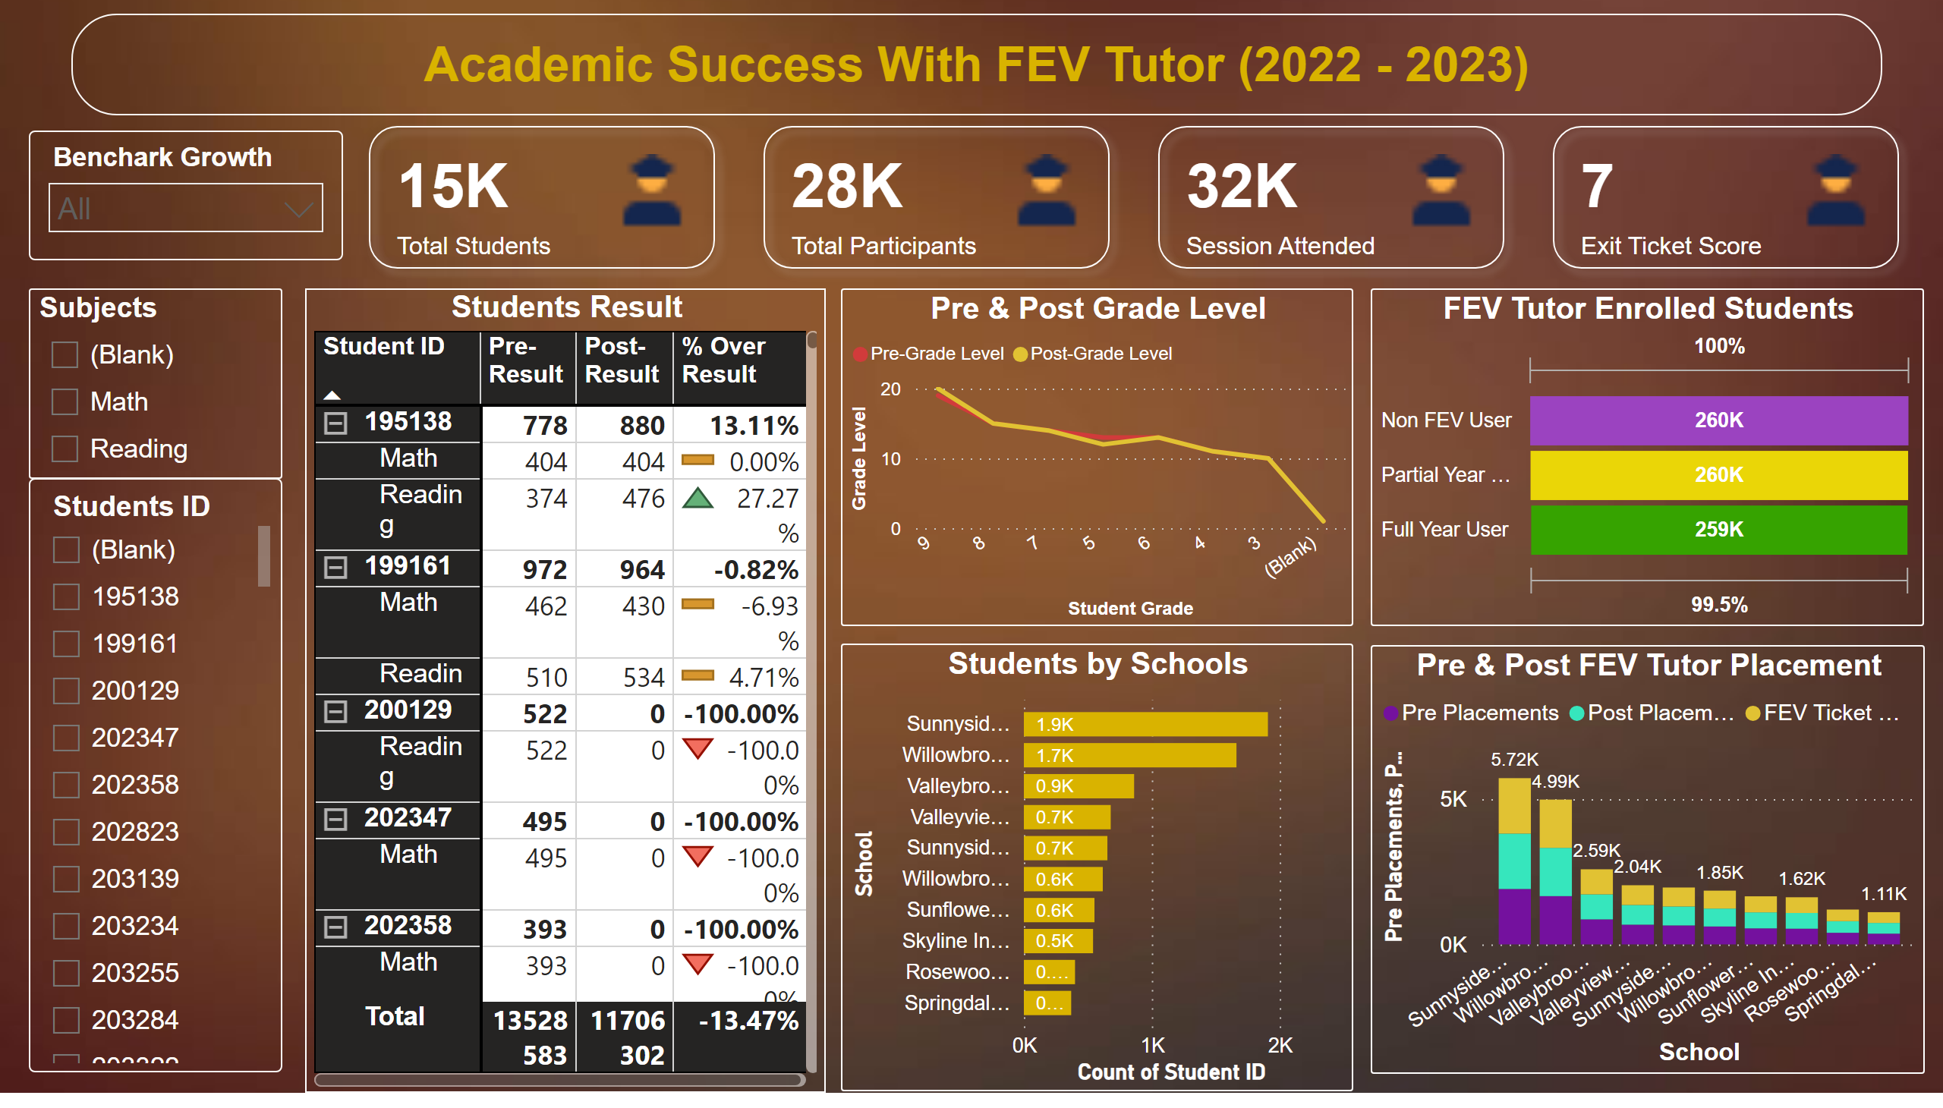
Page 1
Notes:
Students Result
No alt text provided
cardVisual
No alt text provided
actionButton
No alt text provided
Pre & Post FEV Tutor Placement
No alt text provided
Pre & Post Grade Level
No alt text provided
FEV Tutor Enrolled Students
No alt text provided
Students by Schools
No alt text provided
Subjects
No alt text provided
slicer
No alt text provided
slicer
No alt text provided
textbox
No alt text provided

Slide 4
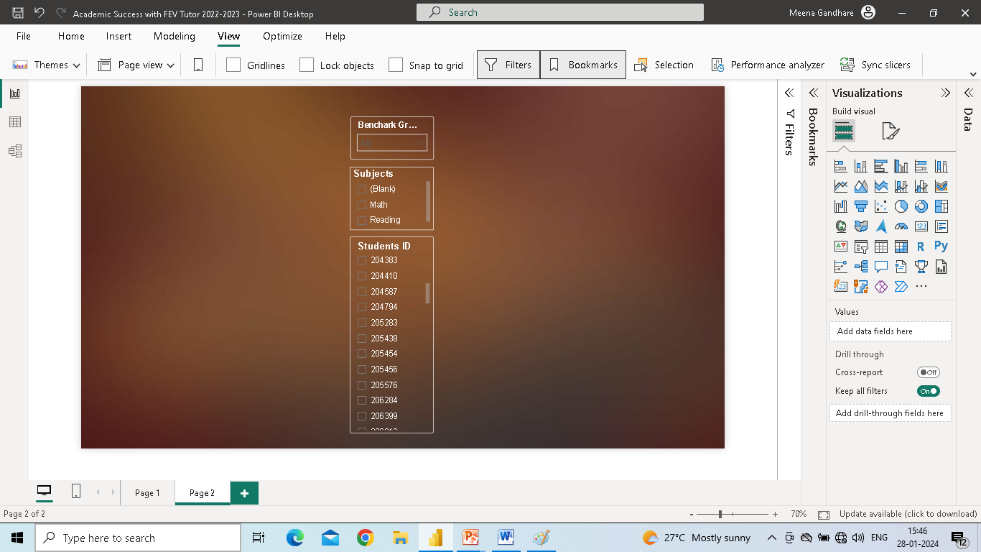
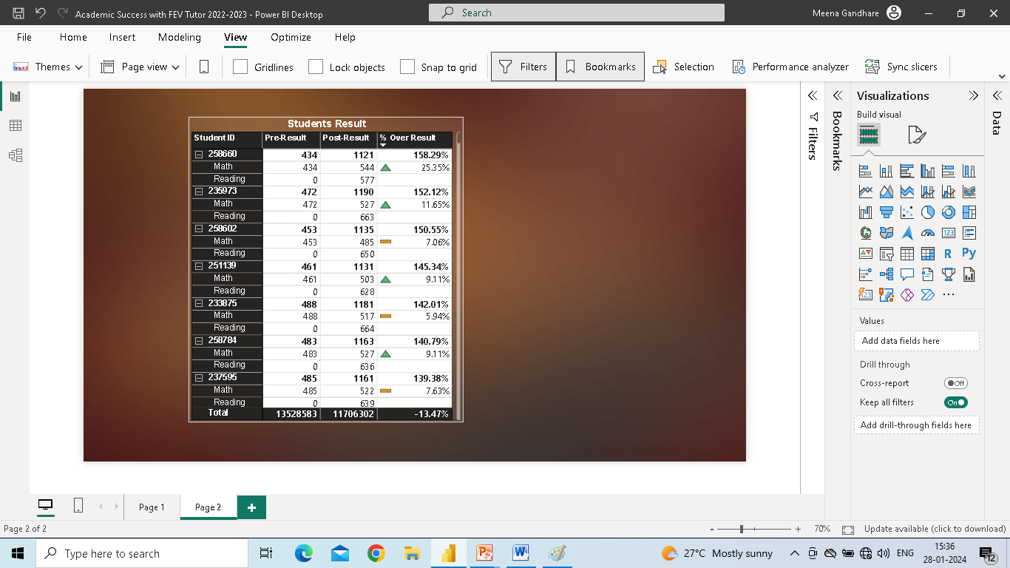
Pre & Post Students Result
I Used Matrix Visual to Analyze Students Pre & Post FEV Tutor’s Test Scores According to Students ID & Subjects.
Extract the Overall Percentage Based on Pre & Post Test, Which Test he/she Got a More Marks.
I Used Three Slicers, First Slicer Indicates the Benchmark Growth of Students.
Second Slicer Shows the Particular Subjects Marks, Students ID & Performance.
And The Third Slicer Indicates Particular Students
Overall Performance & Information.
Slicers
Matrix Visual

Slide 5
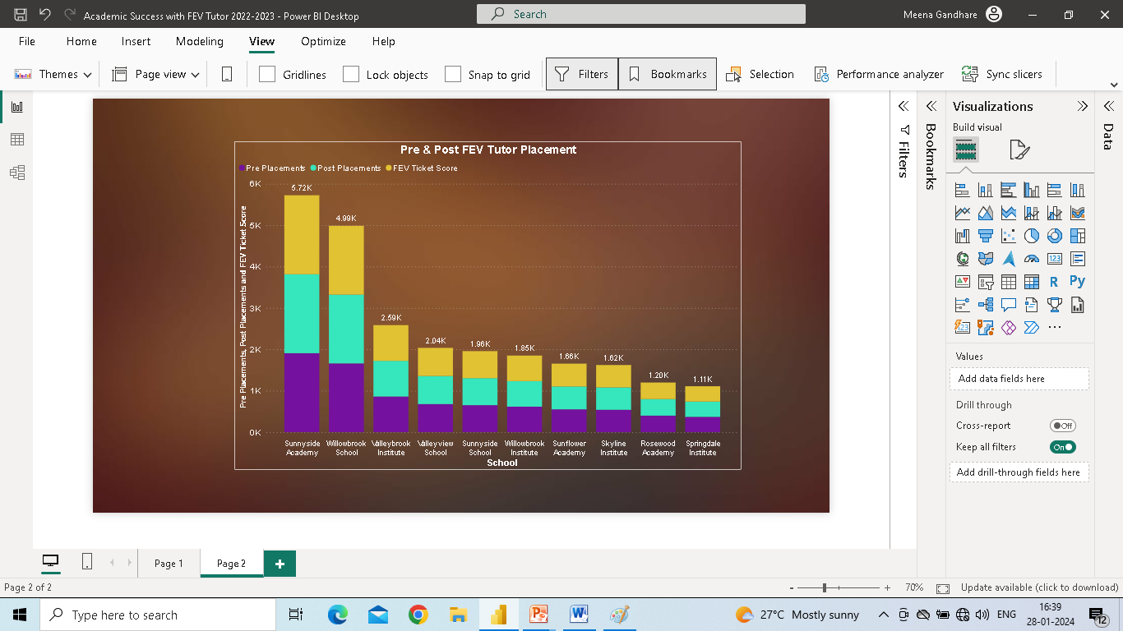
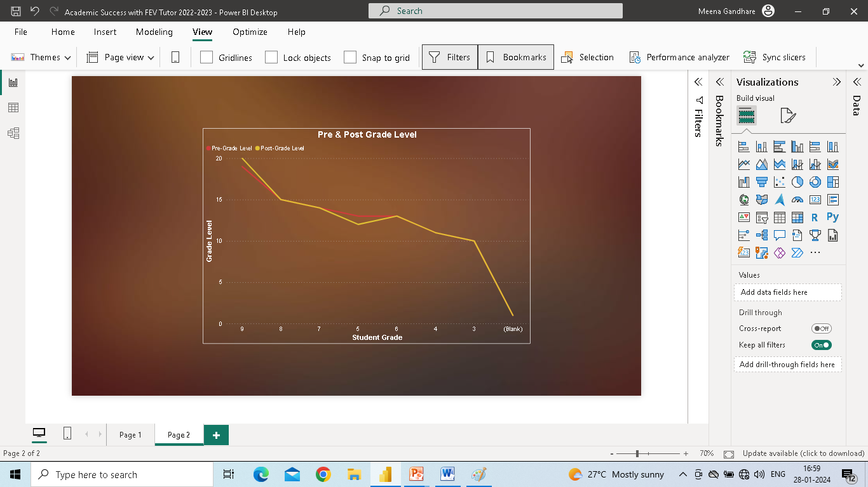
FEV Tutor’s Placements
I Used Stacked Column Chart for Indicating Pre & Post FEV Tutor’s Placements.
Stacked Column Chart
Pre & Post Grade Level
FEV Tutor’s Students Pre & Post Test’s Grade Level by Using Line Chart.
Line Chart

Slide 6
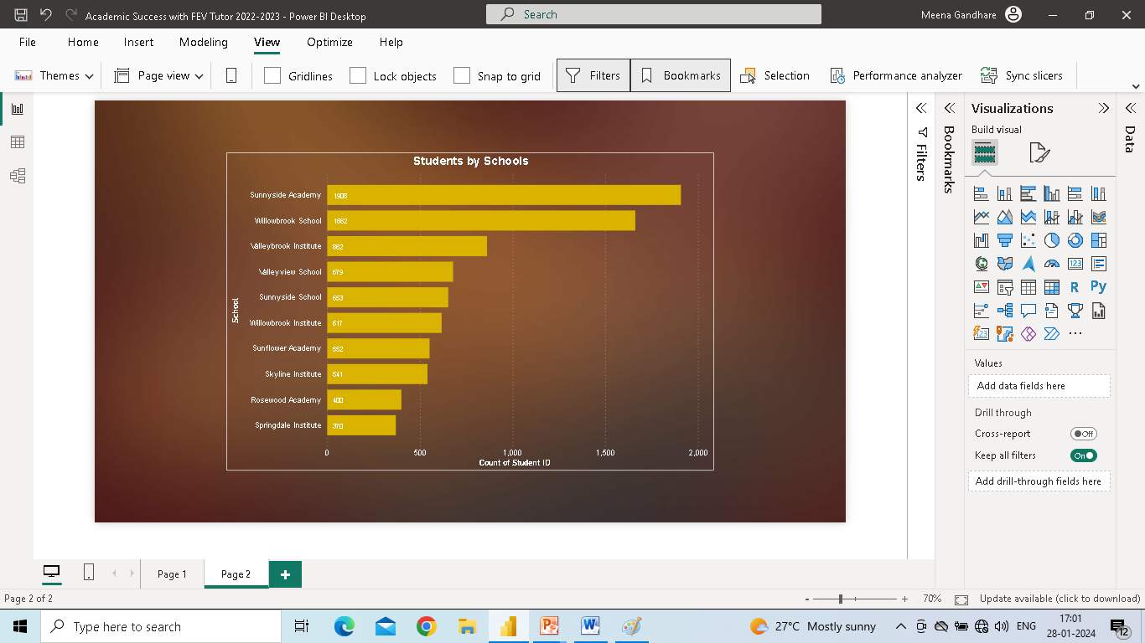
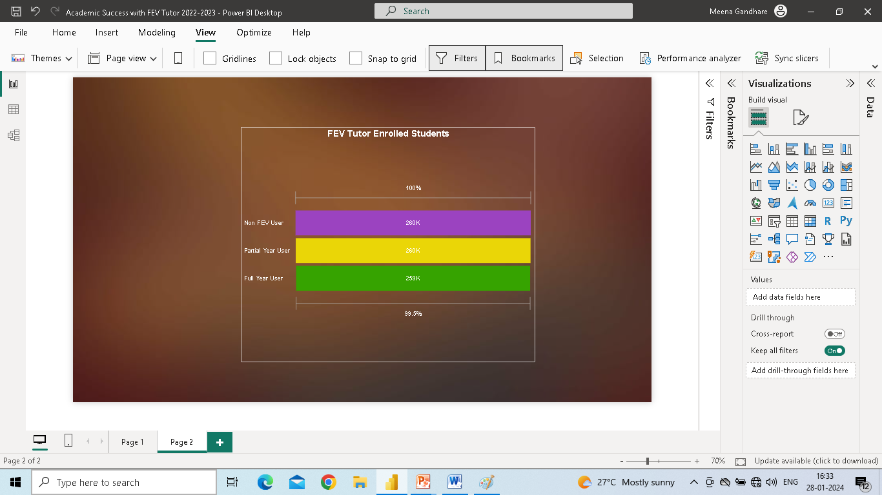
Students by Schools
Indicates How Many Students Belong to the Particular Schools by Using Clustered Bar Chart.
Clustered Bar Chart
Enrolled Students
FEV Tutor’s Enrolled Students, How Many Student’s Belong to the Non-FEV User, Partial Year User & Full Year User.
Funnel Visual

Slide 7
CONCLUTION
FEV Tutor has Proven to be a Valuable Resource for Achieving Academic Success. Its Personalized Approach to Learning and Targeted Support Contribute Significantly to improved Academic Performance.
Students Engage with the Platform, they Benefits from Tailored Assistance, Fostering a Deeper Understanding of Subjects and Enhancing Overall Educational Outcomes.

Slide 8
Thank You

